Slide 1



Decentring the Resilient Teacher: Exploring interactions between teachers and their social ecologies
Dr Steph Ainsworth s.ainsworth@mmu.ac.uk
Dr Jez Oldfield j.oldfield@mmu.ac.uk

Slide 2
Project Overview

Slide 3

The context – Teacher Wellbeing Index 2024
78% of education staff are stressed
46% experience insomnia and trouble sleeping
Is the answer to increase teacher resilience?
35% reported burnout
twix-2024_black-and-white.pdf
S

Slide 4
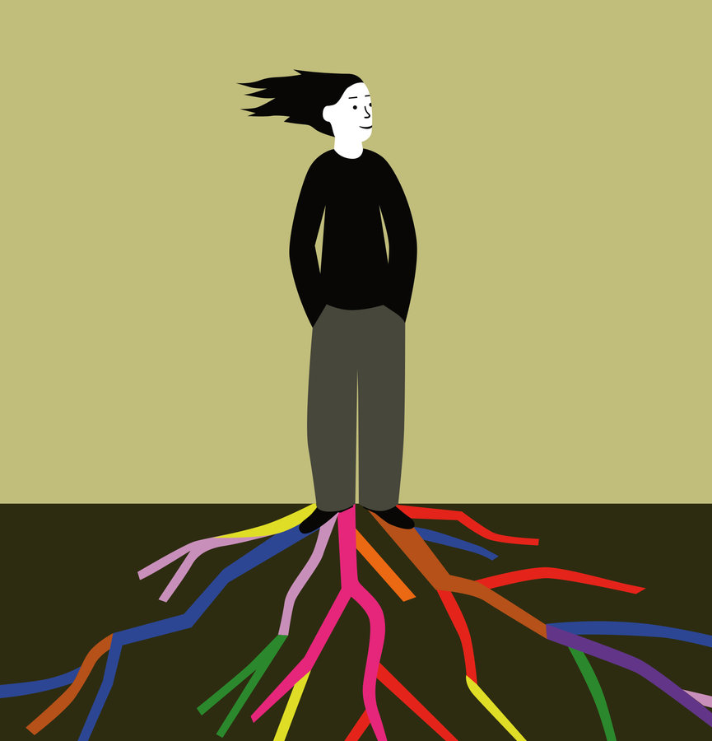
What is resilience?
There is no universally accepted definition of resilience! (Naglieri & LeBuffe 2005).
- “a dynamic process encompassing positive adaptation within the context of significant adversity” (Luthar Cicchetti & Becker (2000)
Not a TRAIT …. It’s a PROCESS - how protective factors overcome risk is essentially resilience.
J

Slide 5
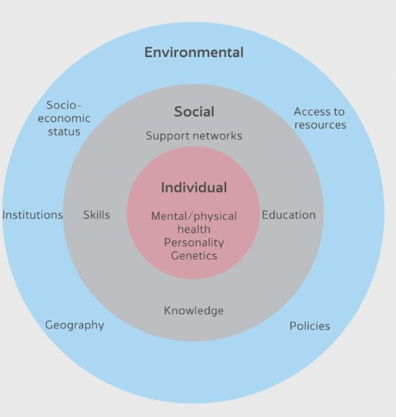
Social-ecological Approach
Protective factors may be located within the individual, but also importantly operate across other ecological domains (Ungar, 2015). This approach avoids the hyper-individualisation discourse of resilience.
For teachers, the protective factors that help promote resilience reside within:
the individual (i.e. emotional intelligence, optimism)
the school level (i.e. support from leadership)
the wider governmental level (i.e. educational policy)
J

Slide 6
Teacher Resilience: A social-ecological approach
Individual Factors
(Optimism)
School Factors (Workload Practices)
Exo-systemic factors (Educational Policies)
Wellbeing
Job Satisfaction
Burnout
J

Slide 7
Project Overview
Work Package 4
Sharing insights with other schools
Oct-Nov 25
Work Package 3
Developing intervention strategies at the individual and school levels
Identifying factors beyond the school
Apr 24-Mar 25
Evaluating the interventions
Apr 25-Jul 25
Work Package 1
Survey to measure factors relating to teacher resilience
April 23
Work Package 4
Creating flexible resources for schools across the UK
Apr 24-Nov 25
Work Package 2
Ecology mapping in schools
Sep-Dec 23
Work Package 4
Creating an online course for student teachers
Apr 24-Nov 25
S

Slide 8
Teacher Resilience Survey
Individual factors
Self-esteem
Emotional intelligence
Personality
Optimism
Self-care
Self-efficacy
Independent problem solving
Investment in pupils
Contextual factors
Conflict between beliefs and practice
Support from colleagues
Support from family and friends
Relationships with parents
Support from leadership
Workload
Pupil behaviour
School culture
Outcomes
Wellbeing
Job satisfaction
Burnout
Demographic factors
Age, gender, ethnicity, role, no. years qualified etc.
n > 3000 teachers .
S

Slide 9
The strongest predictors of 3 resilience outcomes
Wellbeing​ | Job Satisfaction​ | Burnout​
1. Self-esteem​ | 1. Conflict between belief and practice​ ​ | 1. Workload​
2. Self-care​ | 2. Workload​ | 2. Conflict between belief and practice​
3. Workload​ | 3. School Culture​ ​ | 3. Support from Colleagues​ ​
4. Optimism​ | 4. Support from leadership​ | 4. Self-esteem​ ​
5. Emotional Intelligence​ | 5. Support from Colleagues​ | 5. School Culture​ ​
Decentring the ‘resilient teacher’ | Education Research Programme - UCL – University College London
S

Slide 10

1. Promoting Optimistic Thinking
The 3 P’s

Slide 11
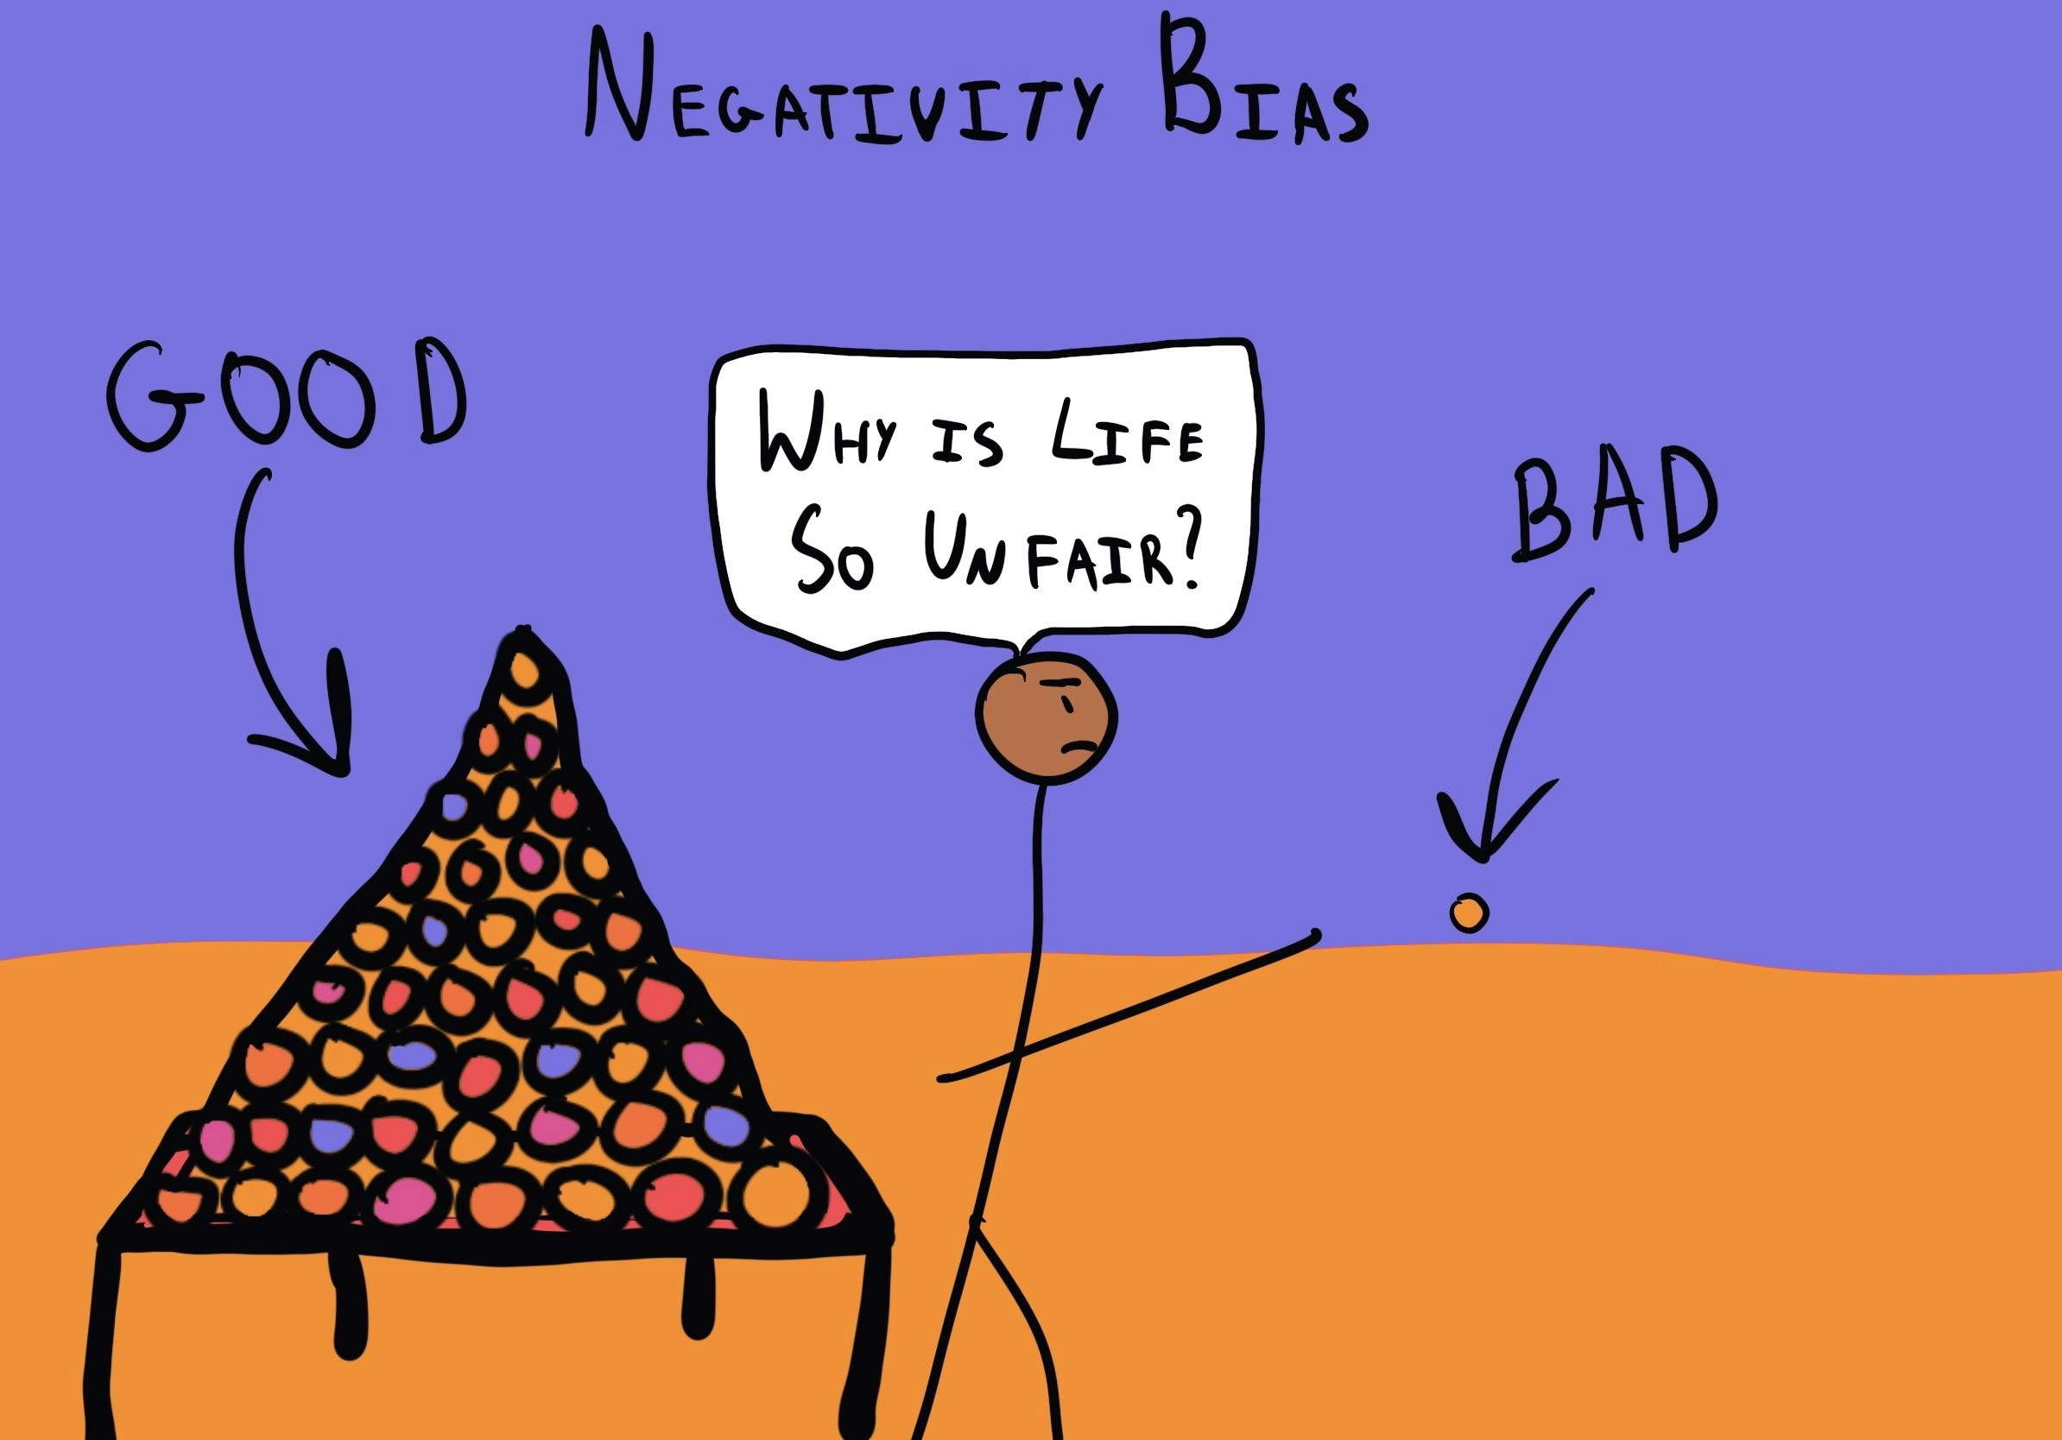
The Negativity Bias
We pay more attention to the negative ​
We often remember the negative events in more detail​
Our decision making is shaped more by the negative experiences​
Our emotional response to negative events is often stronger
J

Slide 12
The three P’s:
When something goes wrong, our brain may interpret it in 3 unhelpful ways:
Personal: “It’s all my fault.”
Pervasive: “Everything is going badly.”
Permanent: “It’s always going to be like this.”

Slide 13
An example:
A lesson goes badly — students were distracted, you ran out of time, and someone made a negative comment.
The 3 P’s might sound like:
Personal: “I’m a terrible teacher.”
Pervasive: “My lessons never go well.”
Permanent: “I’ll never be good at this.”

Slide 14
Now Reframing..
We can learn to reframe:
It's not personal: “There were external factors — timing, class energy, or the topic.”
It's not pervasive: “This was just one lesson. Others have gone really well.”
It's not permanent: “I can adjust this and try again. It will improve.”

Slide 15
Activity 1: Using the 3 P’s
Reflecting and Reframing

Slide 16

Activity: Reflecting..
Think about a challenging experience that you have had whilst teaching..
Now reflect to what extent:
Did I make this personal?
Did I assume it affects everything?
Did I think it will always be this way?

Slide 17

Activity: Reframing
Now reframe that negative experience that you had using the three P model i.e:
It wasn’t personal because…
It didn’t affect everything because …
It won't always be this way because …

Slide 18
Example: A Lesson That Didn’t Go Well
3 P’s | Pessimistic Thinking | Optimistic Thinking
Personal | “I’m just not good at teaching. It’s my fault it went badly.” | “There were a few things that didn’t go well today, but I can learn and adapt. This doesn’t define me.”
Pervasive | “If I can’t manage this one class, I must be a bad teacher altogether.” | “This was one difficult moment in one class — I’m still doing well in many other areas of my teaching.”
Permanent | “It’s always like this with this class. I’ll never improve.” | “Today was difficult, but it doesn’t mean future lessons will be. I’ve had good lessons before, and I will again.”

Slide 19

2. Promoting Emotional Awareness
The ACT model

Slide 20
The ACT model
Helps an individual to shift from being emotionally reactive to emotionally responsive (emotionally intelligent)
Awareness: Recognise what you’re feeling
Check thoughts: What story are you telling yourself?
Try alternatives: Choosing a better response

Slide 21
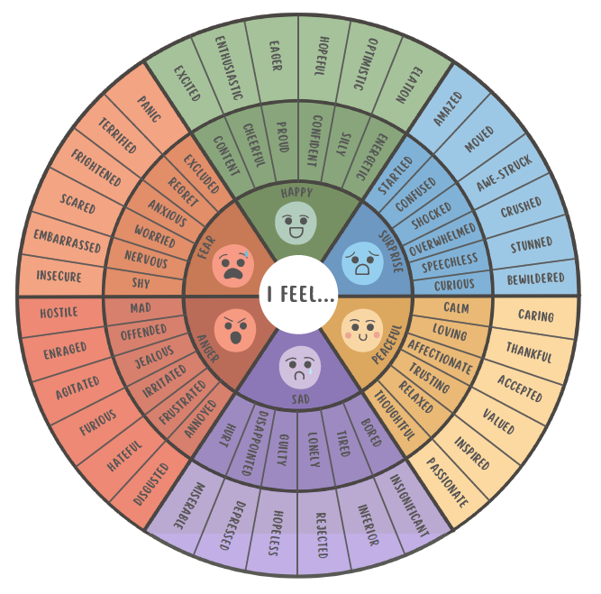
A = Awareness (Recognise what you’re feeling)
The simple act of being aware of your emotions, accepting and labelling the emotion (not as good or bad) can begin the de-escalation of negative emotion.
What exactly am I feeling?
Where is it showing up in my body?

Slide 22

C = Check Thoughts (what story are you telling yourself?)
What are my emotions telling me about the situation I am in?
Evaluating the accuracy and helpfulness of your thoughts
Challenging unhelpful thoughts – i.e. is this thought true? Is it helpful? What’s another explanation?
Avoiding catastrophizing thoughts – replacing (reframing) them with more balanced thoughts

Slide 23

T = Try Alternatives (choose a better response)
What alternative ways of thinking or behaving do I have?
Trying new ways of thinking or behaving that could lead to changes in the challenging situation
Choosing how to respond in a better way once you have reflected on your emotions and thoughts

Slide 24
ACT model: An example – ‘being observed’
Awareness
You have just been observed by a colleague, and you don’t feel your lesson went as well as you would have liked. How do you feel? , Embarrassed, frustrated, anxious...?
(adapted from brite.edu.au)
Check thoughts
What thinking is driving the emotion?
Now my colleague will think I am rubbish...I’m not cut out to be a teacher.
Try alternatives
Try reframing thought pattern: My other lessons this week were much better. My colleague won’t just base her perceptions of me on just one lesson. This is an opportunity to learn and develop my practice further. Everyone makes mistakes/has lessons that don’t go perfectly…

Slide 25
ACT model: An example – ‘a challenging student’
Awareness
You’ve just had a difficult interaction with a student who constantly challenges your authority—talking back, refusing to follow instructions, and distracting others.
How do you feel? - angry, exhausted, scared?
Check thoughts
What thinking is driving the emotion? “This student is out to get me.” “I can’t manage my class—I must be a weak teacher.” These thoughts are likely distorted or exaggerated. Pause and ask yourself: Is this true—or am I catastrophizing? Have I handled other challenging students before? What might be going on for the student beneath the behaviour? Reframe: “This student’s behaviour is difficult, but it’s not a personal attack.”
Try alternatives
Instead of reacting with frustration or withdrawing emotionally, try a different approach:
Plan a calm conversation with the student when emotions have cooled
Seek support and talk to a trusted colleague, mentor, or pastoral lead for perspective or strategy ideas.

Slide 26
Activity 2: Using the ACT model
Being Emotional Aware

Slide 27
Activity: Reflecting..
Think about a challenging experience that you have had whilst teaching..
Reflect:
What was the emotion that you felt?
What thinking was driving that emotion?
What alternative ways of behaving did you have?

Slide 28
Activity: Reflecting..
Now think about a challenging experience that you are currently facing..
Reflect:
What is the emotion that I am feeling?
What thinking is driving this emotion?
What alternative ways of behaving do I have?

Slide 29
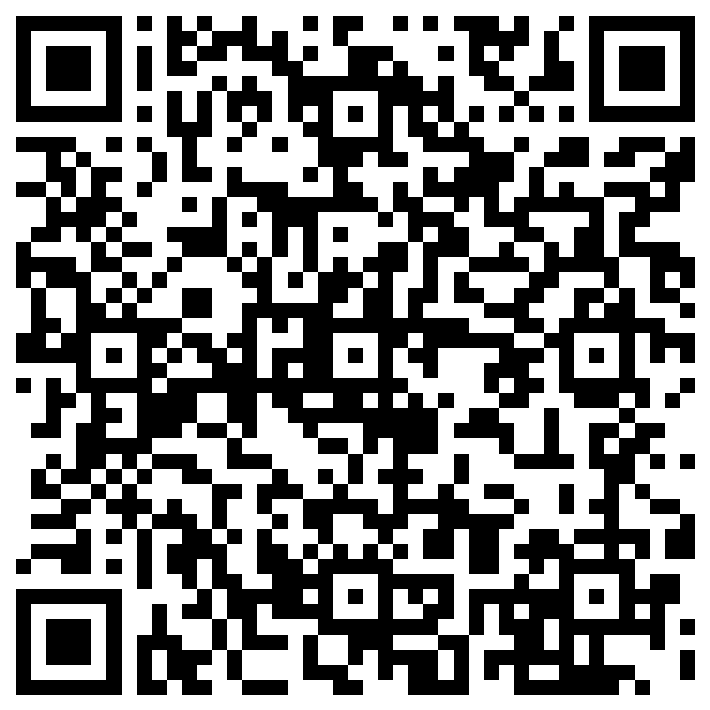
Keep in touch!
Contact Steph or Jez at:
s.ainsworth@mmu.ac.uk
Jez Oldfield
j.oldfield@mmu.ac.uk
If you would like to hear more about the project, contact Steph or Jez at s.ainsworth@mmu.ack or j.oldfield@mmu.ac.uk
Keep an eye out for another webinar in November focusing on school level factors.
If you’d like to receive project updates, including the release of our online teacher resilience toolkit, click or scan here
https://forms.office.com/e/vuTN97yeEJ

